Slide 1




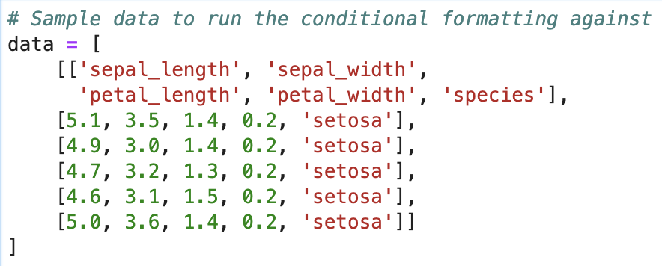
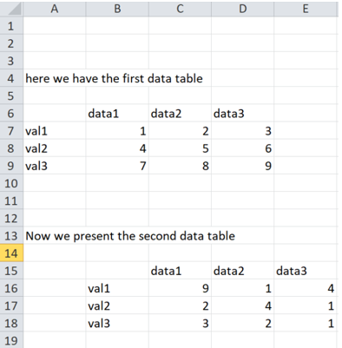
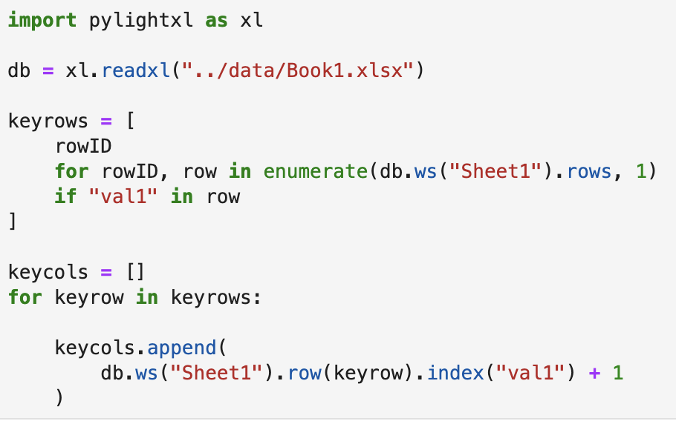

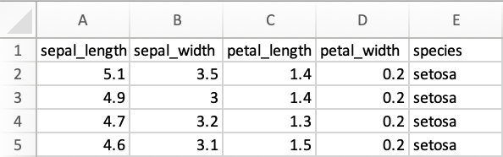


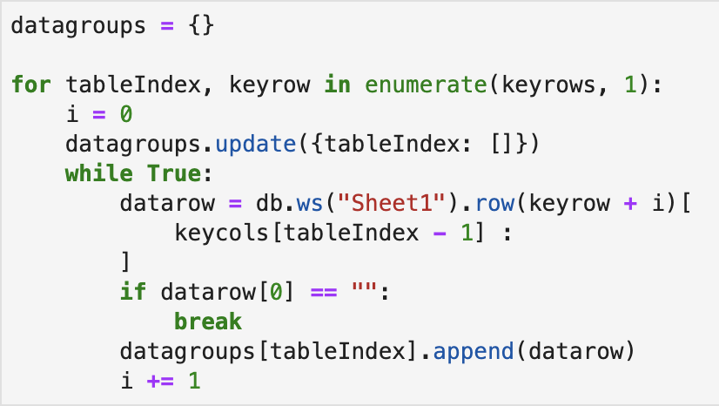
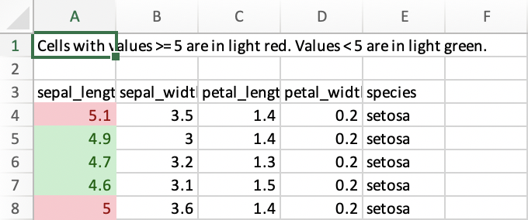
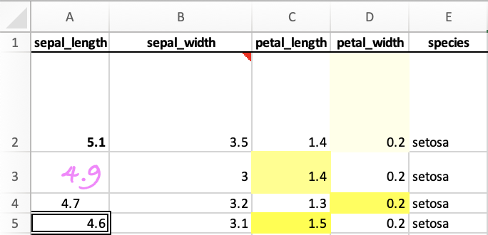

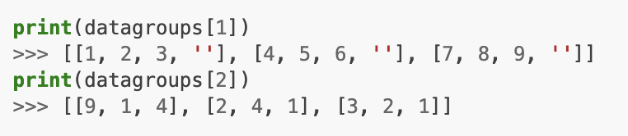
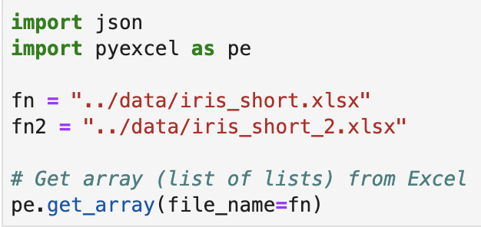
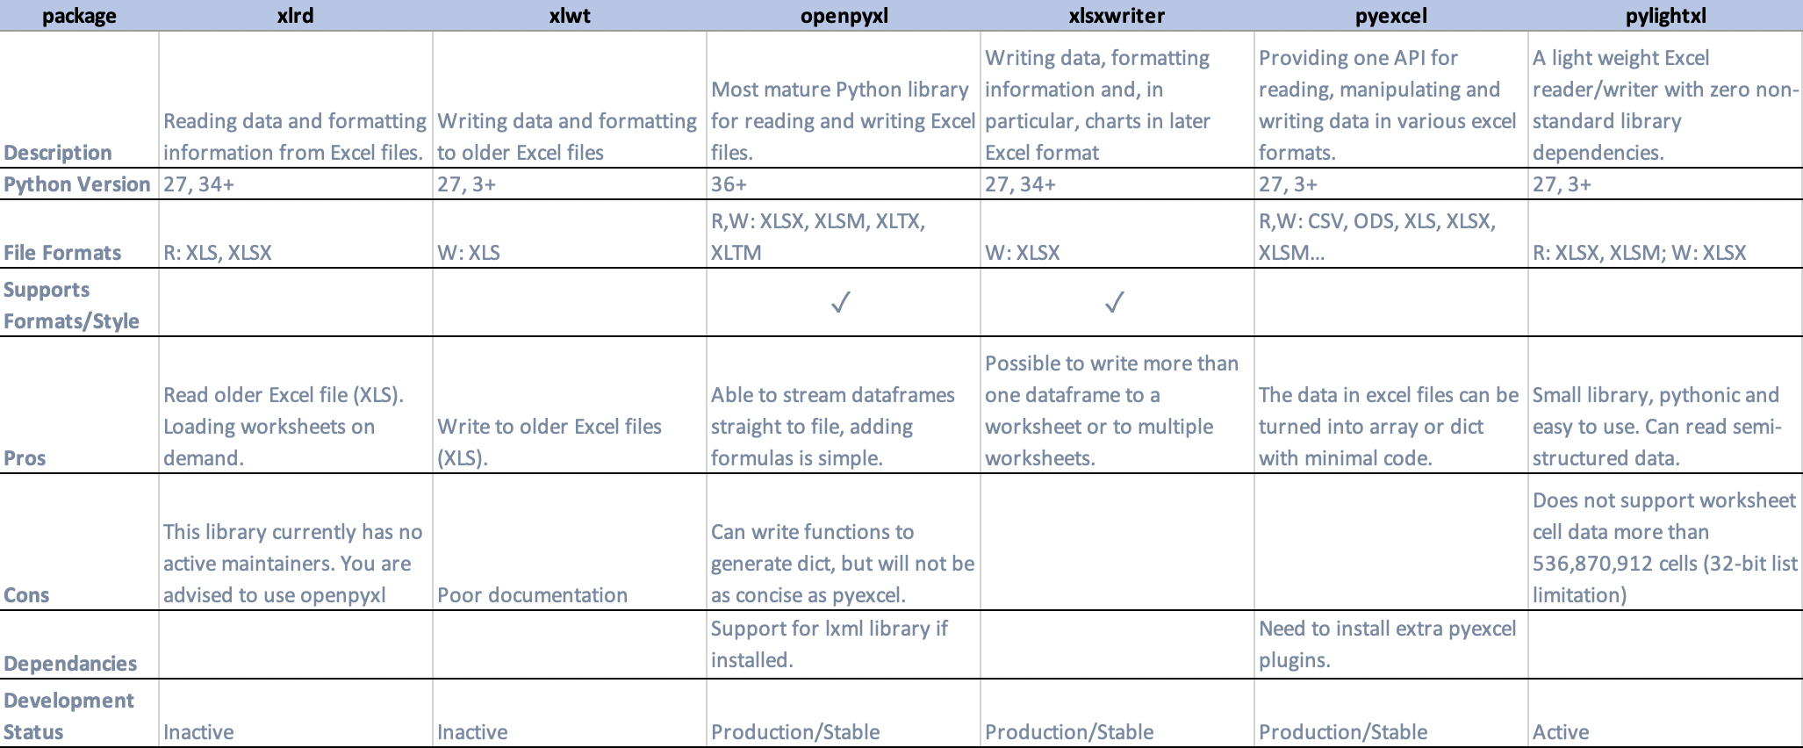
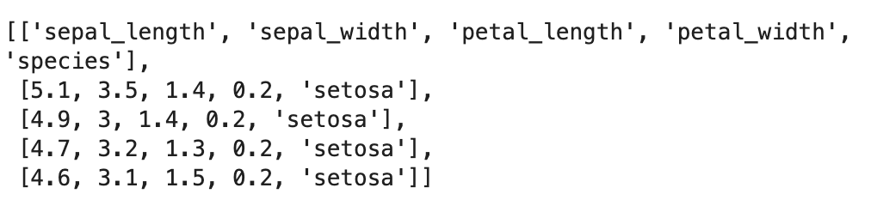
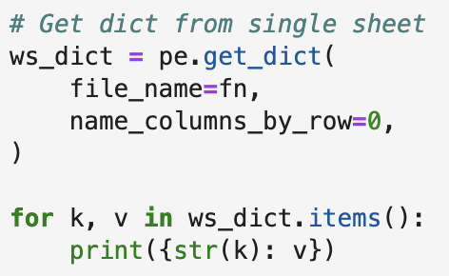
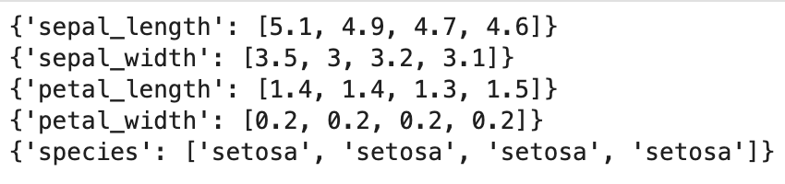
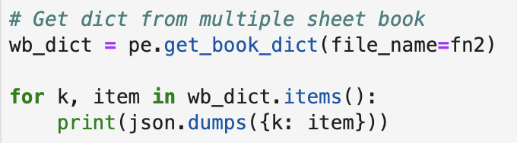
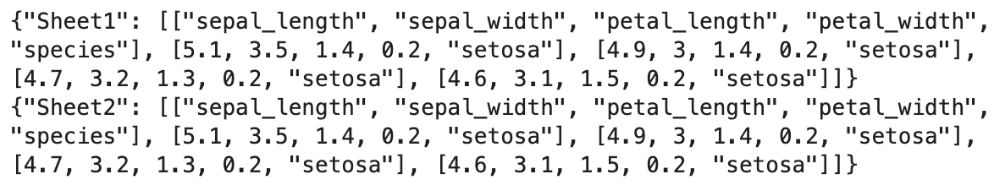
Python Powered Excel:
Focus on Data Instead of File Formats
Jennifer Watt
Human Genome Sequencing Center
Baylor College of Medicine, Houston, TX
Abstract
Packages
Format/Style
Example:
Programmatic manipulation of Excel spreadsheets is a common and useful capability. (Examples)
There are many file formats in use, and many Python libraries with varying capabilities.
This poster is decision-making roadmap in this problem space.
Do you face the common usability problems when an Excel file driven web application is delivered for non-developer users, or need to process different Excel formats for your program?
Not everyone knows (or cares) about the differences between various Excel formats. (i.e. CSV, XLS, XLSX)
Instead of training Excel users about file formats, the various Python libraries help developers to handle most of the Excel file formats by providing a common programming interface.
Working with Excel files in Python
Examples: format with xlsxwriter and style with openpyxl
Input semi-structured data
Key
GitHub Repo
Bitbucket Repo
Integration with Pandas
Input iris dataset (n=5)
xlrd
xlwt
xlutils
openpyxl
xlsxwriter
pyexcel
Example of how to add conditional formatting to a range of cells (i.e. A4:A8 )
Better for formulas and formatting
xlsxwriter
openpyxl
Better for style
Output datagroups
Library Comparison
Information on python packages available to work with Excel files on Python platform
xlutils collects utilities that require both xlrd and xlwt; the use cases are now covered by openpyxl. (omitted in table)
Example: pyexcel
Recommendations
Based on the Library Comparison table, here are the recommendations:
In general, if you are using older Excel files (XLS), use xlrd/xlwt (reader/writer).
xlsxwriter supports full formatting and more.
If you want to add style to output files, openpyxl can generate nicely formatted spreadsheets (powerful feature of traditional spreadsheet). It supports format styles, add comment, add charts and tables, parse formulas, protect workbook from modification.
If output of the data in Excel files is array or dict, you can use pyexcel with minimal code.
If input is semi-structured data (single sheet that can begin with any row/col and has any number of rows/col per data group), use pylightxl.
References
Contact
Acknowledgements
The best place to start when working with Excel files in Python is this website:
http://www.python-excel.org
pyexcel provides one application programming interface to read, manipulate and write data in various excel formats:
http://docs.pyexcel.org/en/latest/
pylightxl is my more recent discovery (the writer part was being written as I was exploring):
https://pylightxl.readthedocs.io/en/latest/
Contact via:
+ : provocateurtx@yahoo.com
Mahitha Rajendran for constructive feedback and Walker Hale for being the source of encouragement, both at Baylor College of Medicine, Houston, TX.
Viktor Kis for allowing me to use the pylightxl logo and code snippets.
Autumn Watt at Intel, Inc. for her honest critique and brilliant style editing.
Kevin Burleigh for his critical yet thoughtful review.
MakeSigns for the Scientific Poster PowerPoint template and helpful chat.
: https://github.com/BCM-HGSC/pycon2020_excel_poster

